Slide 1
ANALYSIS OF REAL-WORLD TURBINE PERFORMANCE USING FORWARD-FACING NACELLE LIDAR
John Medley, Chris Slinger, Rhys Evans, Michael Harris
ZephIR Lidar
Simon Feeney
Renewable Energy Systems
PCWG meeting, 16th Dec 2014; presented at AWEA Wind Resource & Project Energy Assessment Seminar December 2014

Slide 2
introduction
Ground-based lidar are being ever more widely used to provide bankable data for resource assessment.
The use of turbine-mounted lidar is becoming increasingly widespread for diagnosing turbine faults such as wind / yaw misalignment.
Turbine power curves can be measured with lidar in locations where met masts cannot be sited. Measurements of shear, veer and turbulence can help to give more comprehensive power curves.
Measurements made using a turbine-mounted continuous-wave (CW) scanning lidar contain a rich wealth of information on the wind field approaching the turbine.
Can we mine some of that information to improve our understanding of the wind field, and to give us better real-world power curves?

Slide 3
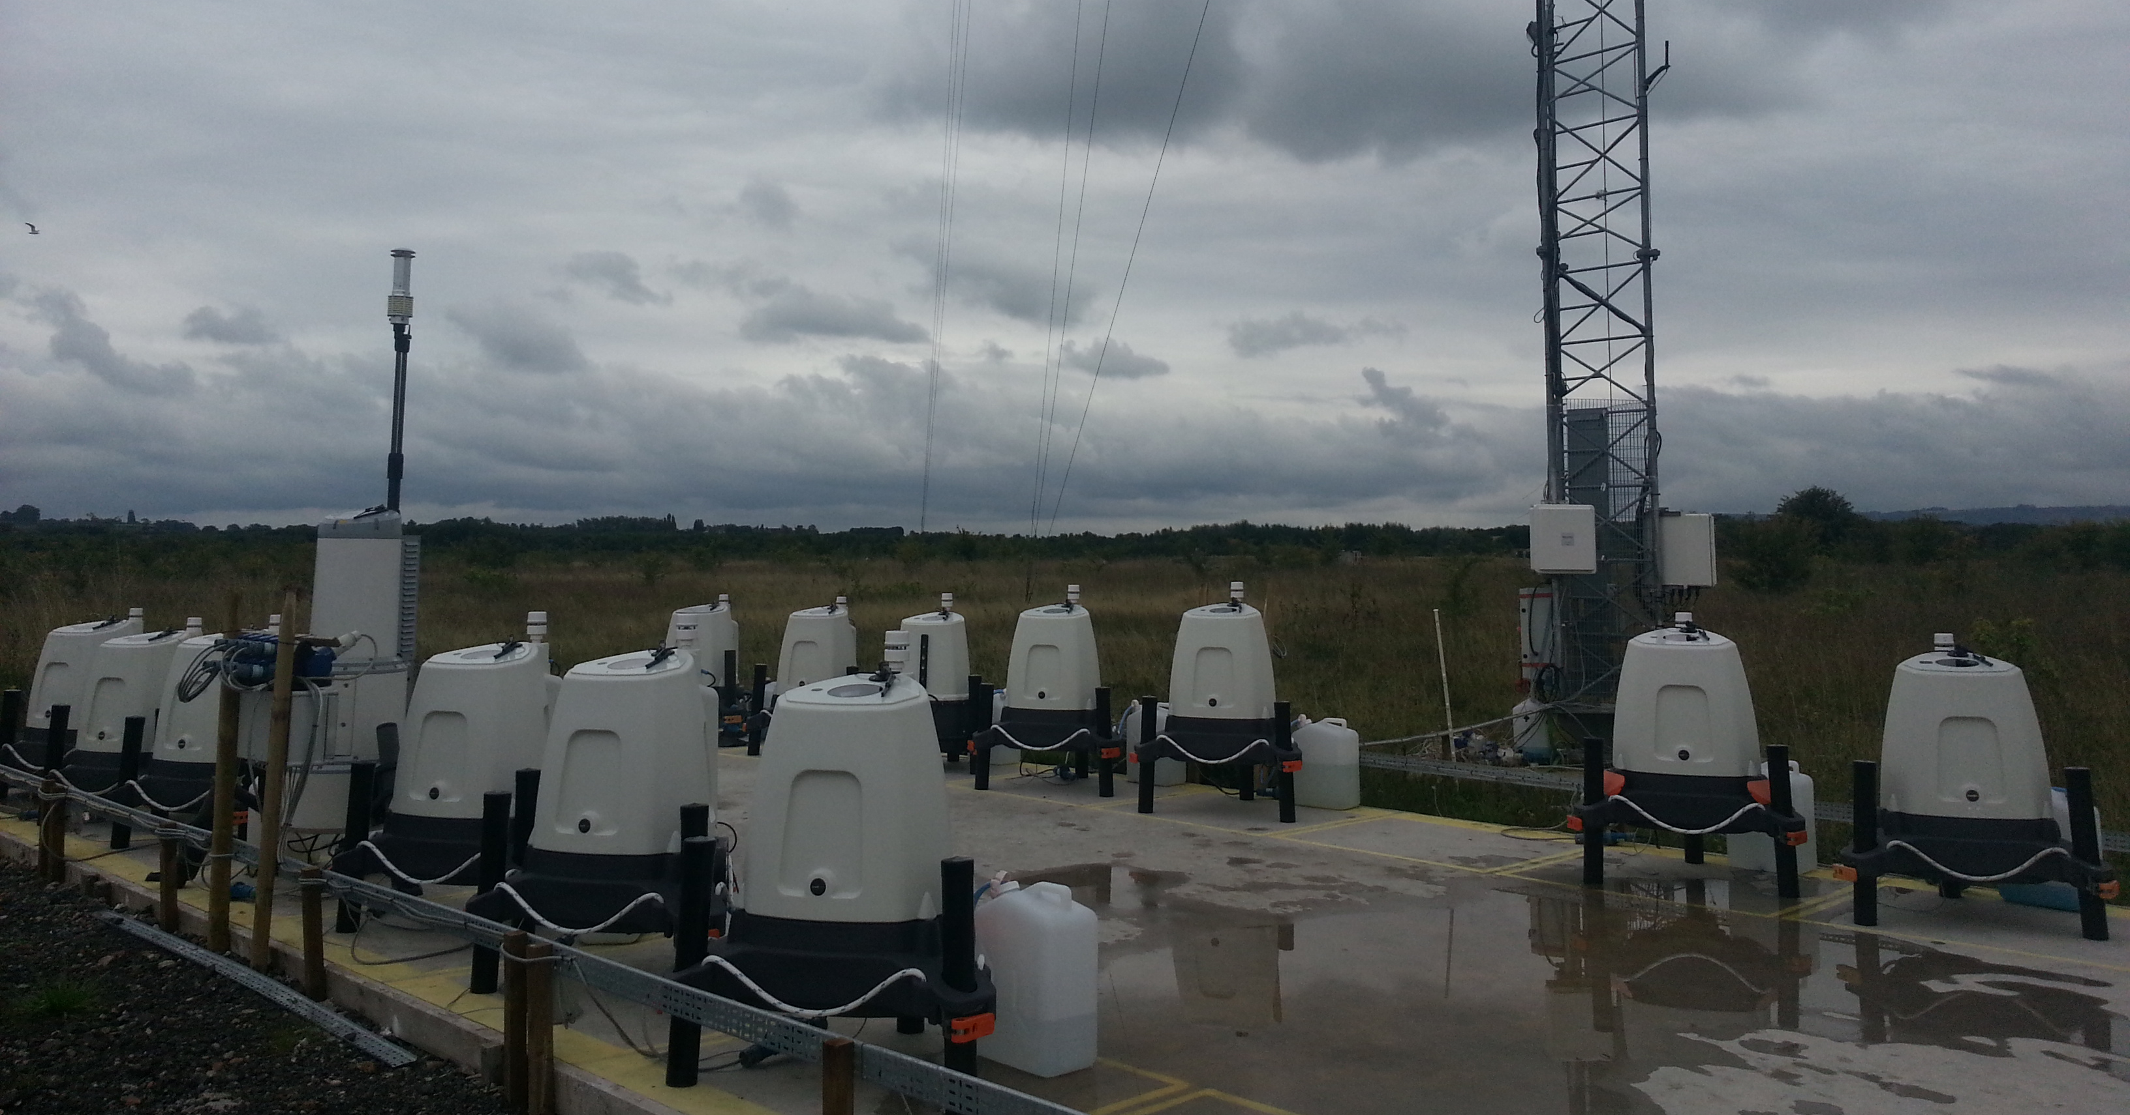
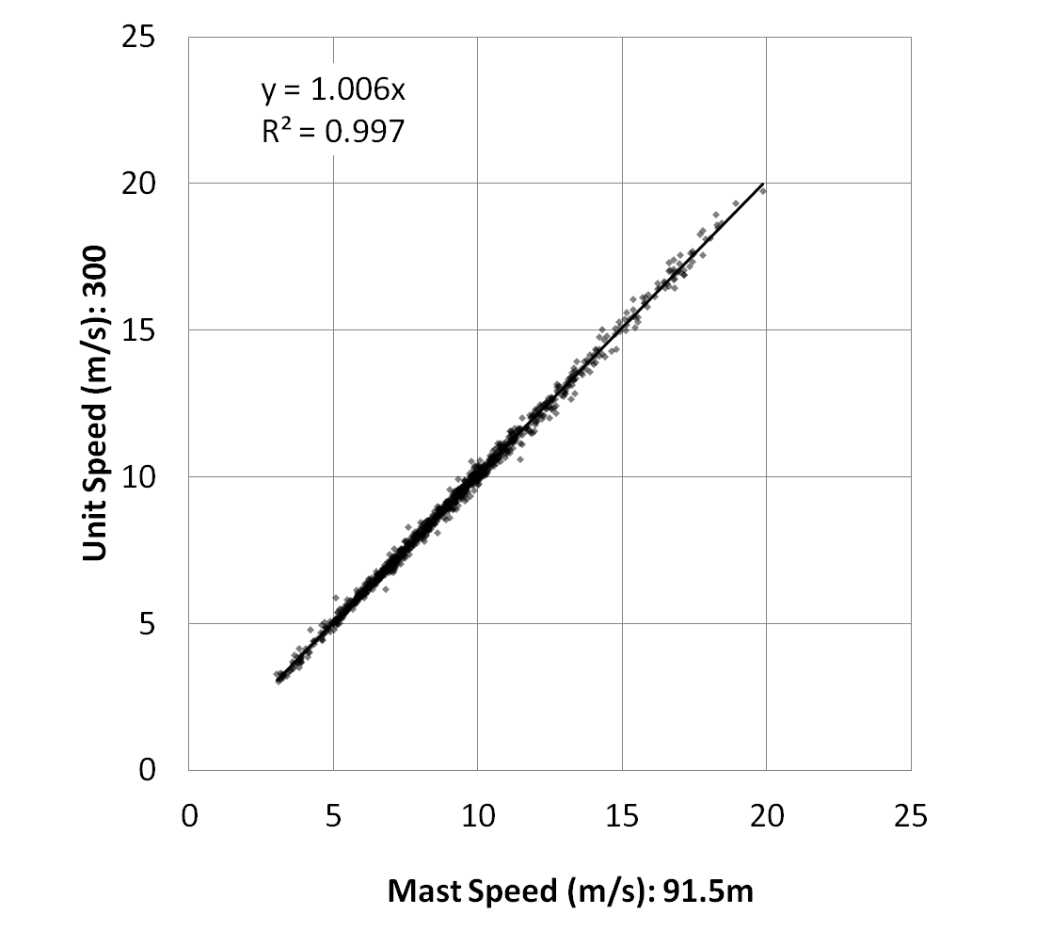
Verification of ground-based lidar performance
Lidar calibration and performance validation process
Rutherford et al, ZephIR Lidar
AWEA 2012

Slide 4
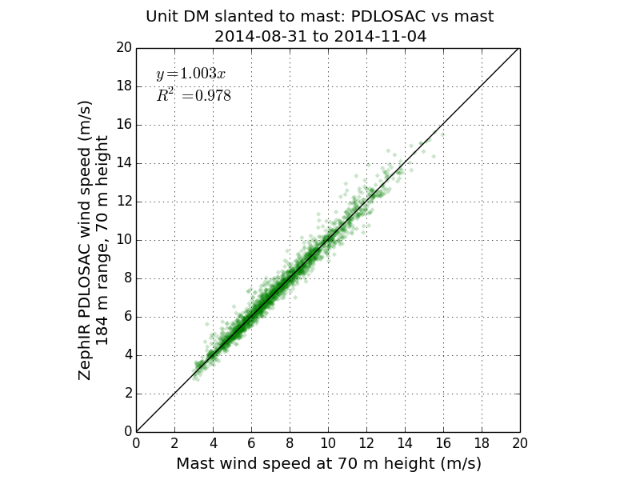

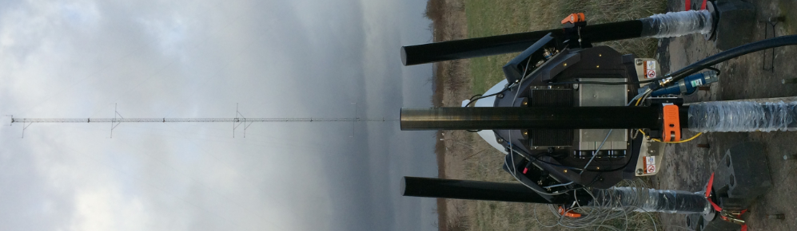
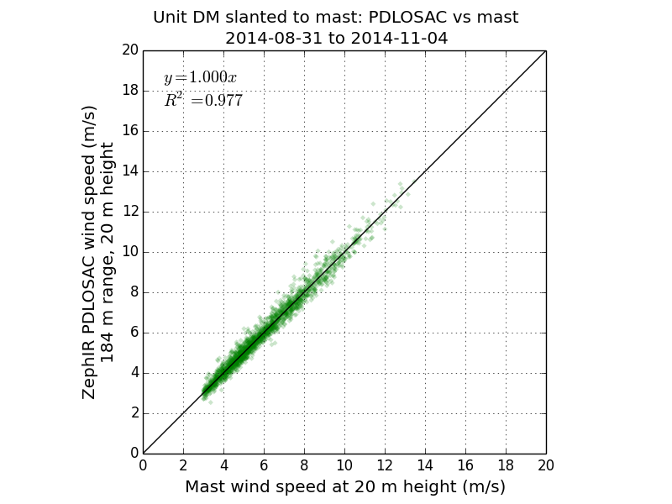
Verification of turbine-mounted lidar performance
ZephIR vs Mast
ZephIR wind speed at 70 m height (m/s)
ZephIR vs Mast
ZephIR wind speed at 45 m height (m/s)
ZephIR vs Mast
ZephIR wind speed at 20 m height (m/s)

Slide 5
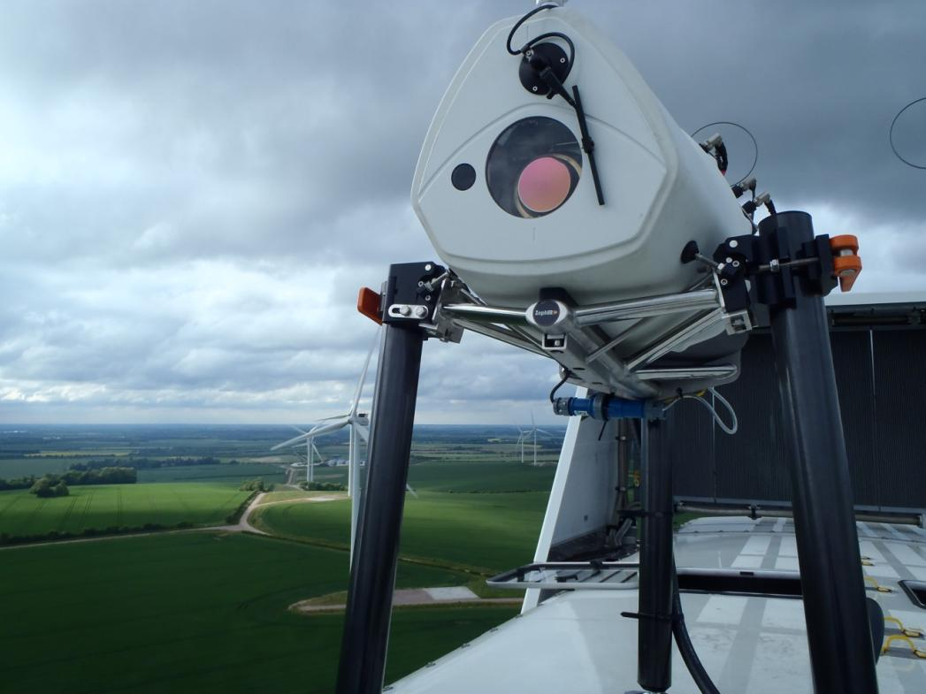

Case Study – Nacelle LiDAR Power Performance Project
Eye of the Cyclops

Slide 6
Project Cyclops Motivations
Vh
Why use a Nacelle Mounted LiDAR?
Cheaper – savings ~ £100,000/turbine
Quicker, more flexible, more turbines
Test at any point in turbine lifetime
Yaw Error
More information - Shear, inflow and veer
Better for complex terrain?
VLHS
2α
Vh
VRHS
Vh
α - γ
VLHS
2α
VRHS
Vh
α + γ

Slide 7
Project Cyclops Measurement Set-Up
U₅
U₄
U₃
U₂
U₁

Slide 8
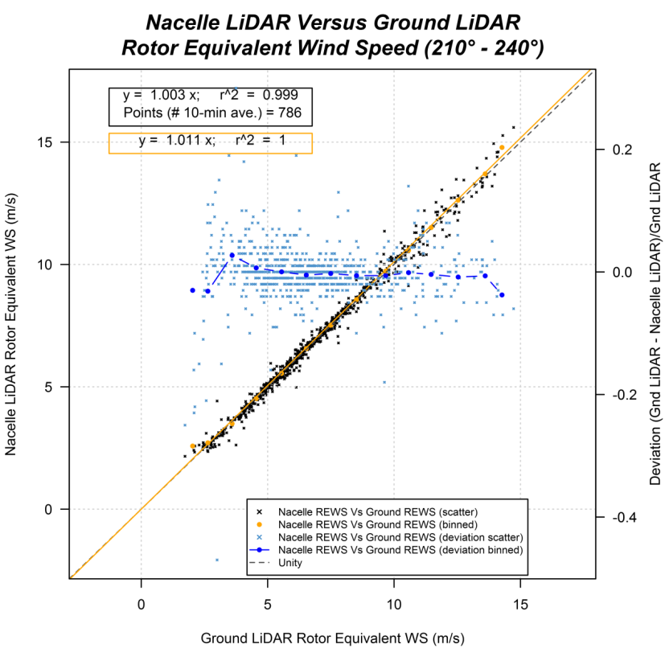
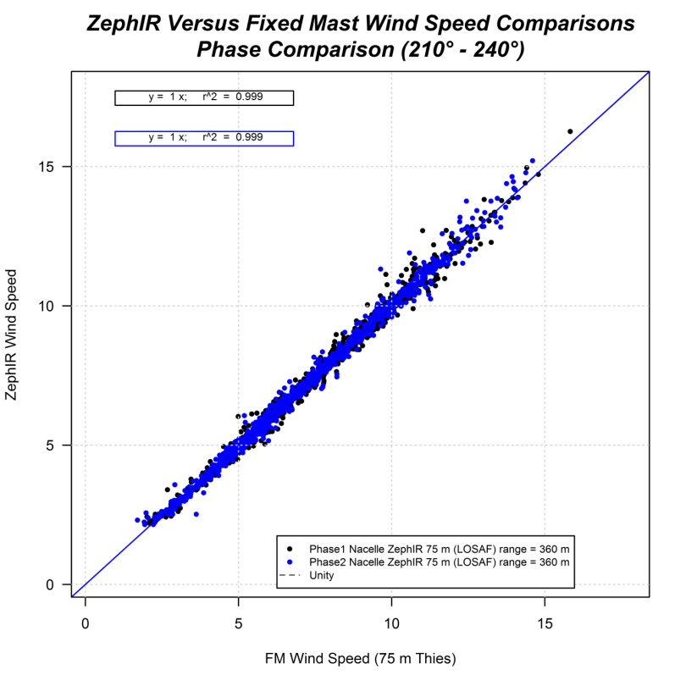
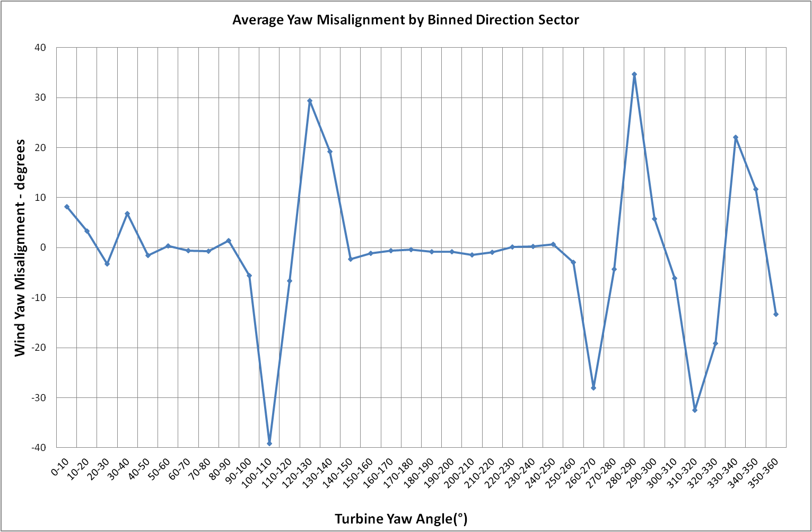
Project Cyclops - Some Results
Correlating 10-minute averaged wind speeds:
Nacelle lidar HH vs Met Mast HH: y = 1 x
Nacelle lidar REWS vs Ground lidar REWS: y = 1.003 x
Very low scatter
Yaw error negligible

Slide 9
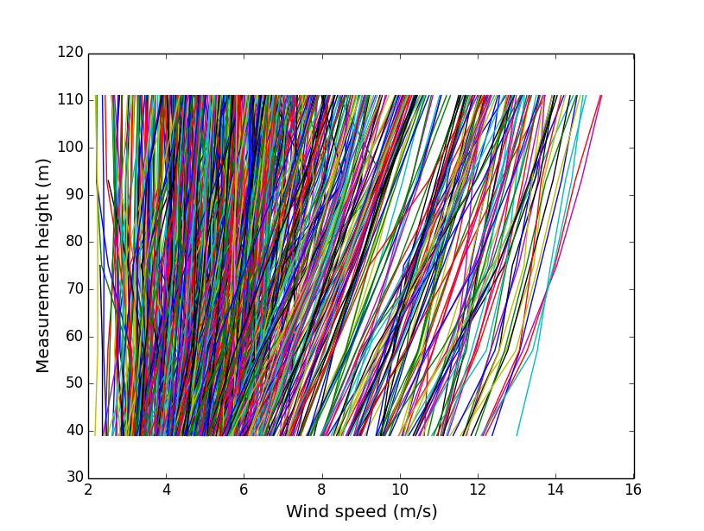
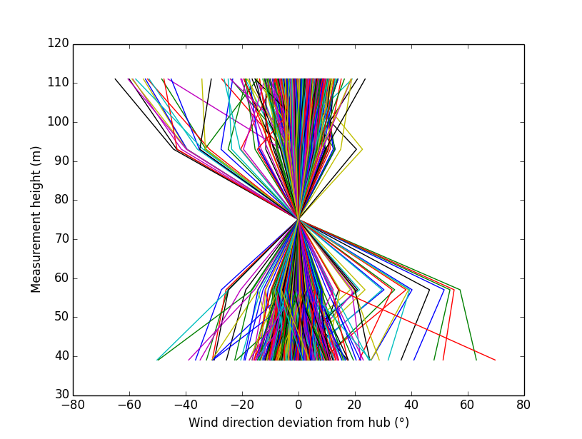
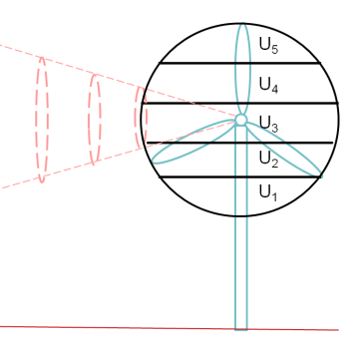
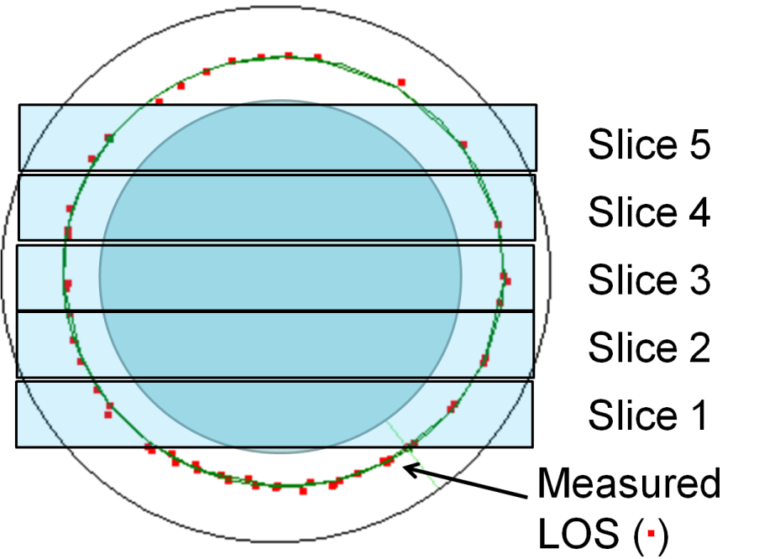
Shear, veer and rews
Shear and veer profiles for 1 day of project cyclops
Wind speed and direction can be measured at several heights across the rotor diameter revealing the shear and veer profile
Rotor equivalent wind speed
Rotor-equivalent wind speed (REWS) accounts for shear and veer across the rotor diameter giving a better representation of the energy in the wind

Slide 10
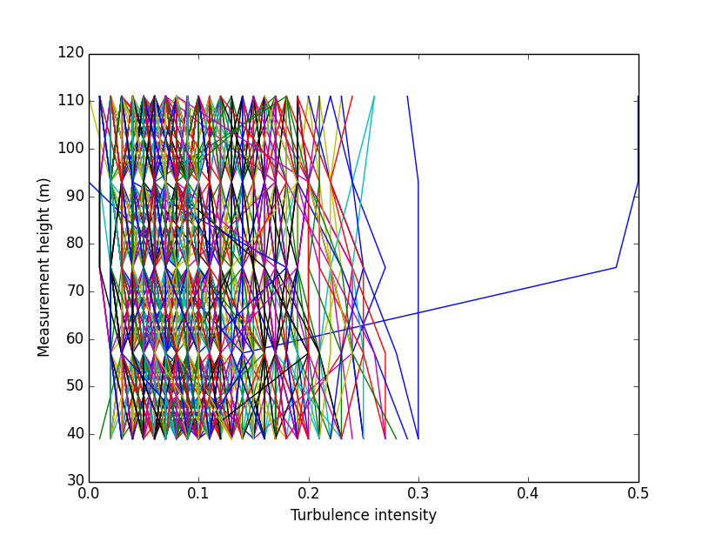
Turbulence intensity
TI profiles for 1 day of project cyclops
TI can also be measured at several heights across the rotor diameter.
How that information can best be used to improve power curves is open to debate – should we have a “rotor-equivalent TI”?
Ti renormalisation
A TI renormalisation procedure is available to correct from the reference turbulence intensity to any required TI, assuming a Gaussian Normal distribution of wind speeds within each 10 minute averaging period.
How valid is that assumption?
Can we detect and filter for non-Normality?

Slide 11
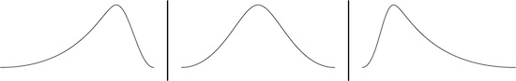
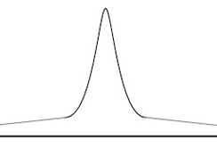
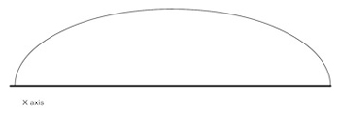
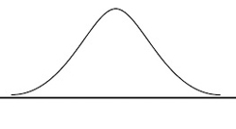
Non-normality of wind speed distribution
Simple measures of normality
The skewness and kurtosis are statistics describing the shape of a probability distribution.
They are based on the third and fourth moments of the data respectively (the mean is based on the first moment, the variance on the second moment).
As defined below, both skewness and kurtosis are zero for a Normal distribution.
zero / Normal
negative
positive

Slide 12
Output power as function of input power
Cube-root-mean-cubed speeds
Is the turbine’s output a more direct function of the kinetic energy in the wind, rather than the wind speed?
If so, should we be averaging kinetic energy, rather than speed?
Average wind speeds as cube-root-mean-cubed (CRMC) of individual speed measurements?

Slide 13
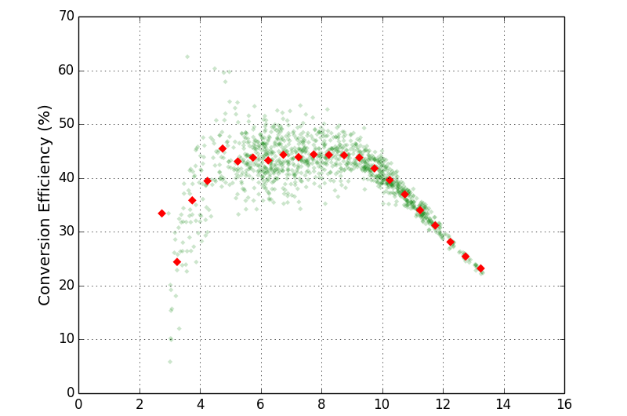
Conversion efficiency
Cp vs Hub Height Wind Speed
Conversion efficiency (%)
Wind speed (m/s)

Slide 14
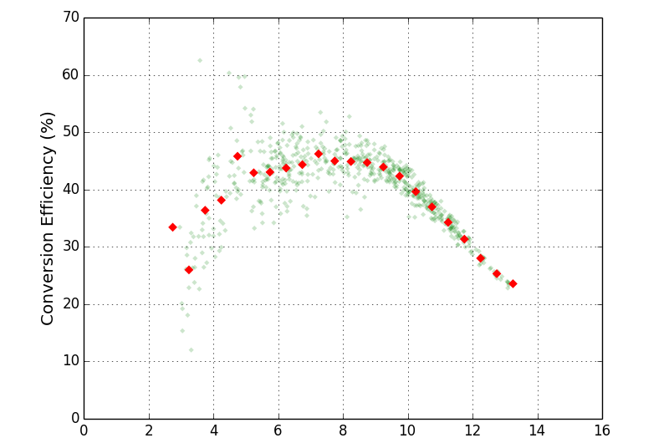
Conversion efficiency
Cp vs Hub Height Wind Speed (KURTOSIS < 0.5)
Conversion efficiency (%)
Wind speed (m/s)

Slide 15
Conversion efficiency
Cp vs Hub Height Wind Speed
Conversion efficiency (%)
Wind speed (m/s)

Slide 16
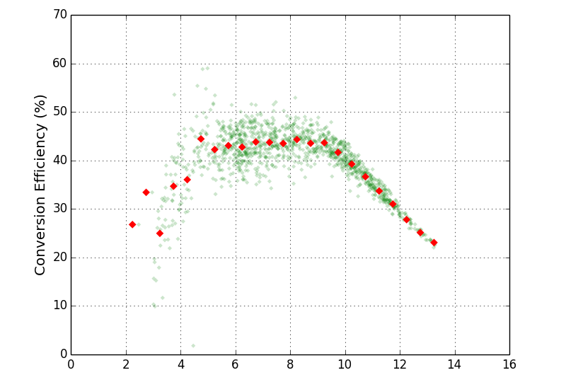
Conversion efficiency
Cp vs Hub Height Wind Speed (CRMC)
Conversion efficiency (%)
Wind speed (m/s)

Slide 17
summary
In simple terrain / offshore, ZephIR measures accurate hub height and rotor equivalent wind speeds.
Nacelle-mounted CW lidar provides a rich source of information on wind field characteristics for analysing turbine performance.
Fundamental assumptions about the best method of processing data can be tested.
The cube-root-mean-cube approach more directly relates available energy in wind to power produced.
Further analysis of existing data sets can help to evaluate the relative benefits of these different approaches.

Slide 18
One final thought…
An attempt to encapsulate the challenge for lidar
An assumption: if we know everything about the incoming 3D vector wind field and other relevant atmospheric parameters, then it should be possible (at least in principle) to relate this deterministically to a precise wind turbine output power?
So a task for lidar suppliers is to devise the best subset of that complete set of measurements, and to process the data so as to:
Provide the closest possible approximation to idealised deterministic behaviour, giving low-uncertainty, low-scatter power curves
Hence, give high confidence in any assessment of turbine under- (or over-) performance
But, must also be consistent with providing a financially-viable solution
We (i.e. lidar suppliers) will need input from others to arrive at the best solution

